Slide 1

GENERAL PHYSICS II Course Code: PHY 102 Session: 2023/2024
3080
OLADEJO O. F. (Ph.D)
Department of Physics
Faculty of Basic and Applied Sciences

Slide 2
Course Description
Electrostatics – Electric charges and fields. Gauss’s Law. Electric Potential, Properties of Electric Charges, Charging by Conduction, Charging by induction, Coulomb’s Law, The Electric Field, Electric Field Lines, Electric Flux and Gauss’s Law, Electric Potential and Potential Energy Due to Point Charges, Capacitance, Combinations of Capacitors,

Slide 3
Course Schedule
Properties of Electric Charges,Charging by Conduction, Charging by induction, Coulomb’s Law
The Electric Field, Electric Field Lines, Electric Flux and Gauss’s Law, Capacitance, Combinations of Capacitors,

Slide 4
Week 1 – Properties of Electric Charges, Charging by Conduction, Charging by induction, Coulomb’s Law
Experiments demonstrate that there are two kinds of electric charge, which Benjamin Franklin (1706 – 1790) named positive and negative
On the basis of observations, it is concluded that like charges repel one another and unlike charges attract one another.
Objects usually contain equal amounts of positive and negative charge —electrical forces between objects arise when those objects have net negative or positive charges.
Charge transfers readily from one type of material to another

Slide 5
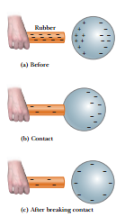
electric charge is always conserved
In conductors, electric charges move freely in response to an electric force. All other materials are called insulators.
Charging by Conduction

Slide 6
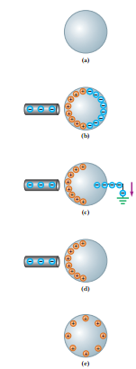
Charging by Induction

Slide 7
Coulomb’s Law
In 1785 Charles Coulomb (1736 – 1806) experimentally established the fundamental law of electric force between two stationary charged particles.
An electric force has the following properties:
1.It is directed along a line joining the two particles and is inversely proportional to the square of the separation distance r, between them.
2.It is proportional to the product of the magnitudes of the charges, q1 and q2, of the two particles.
3.It is attractive if the charges are of opposite sign and repulsive if the charges have the same sign.

Slide 8
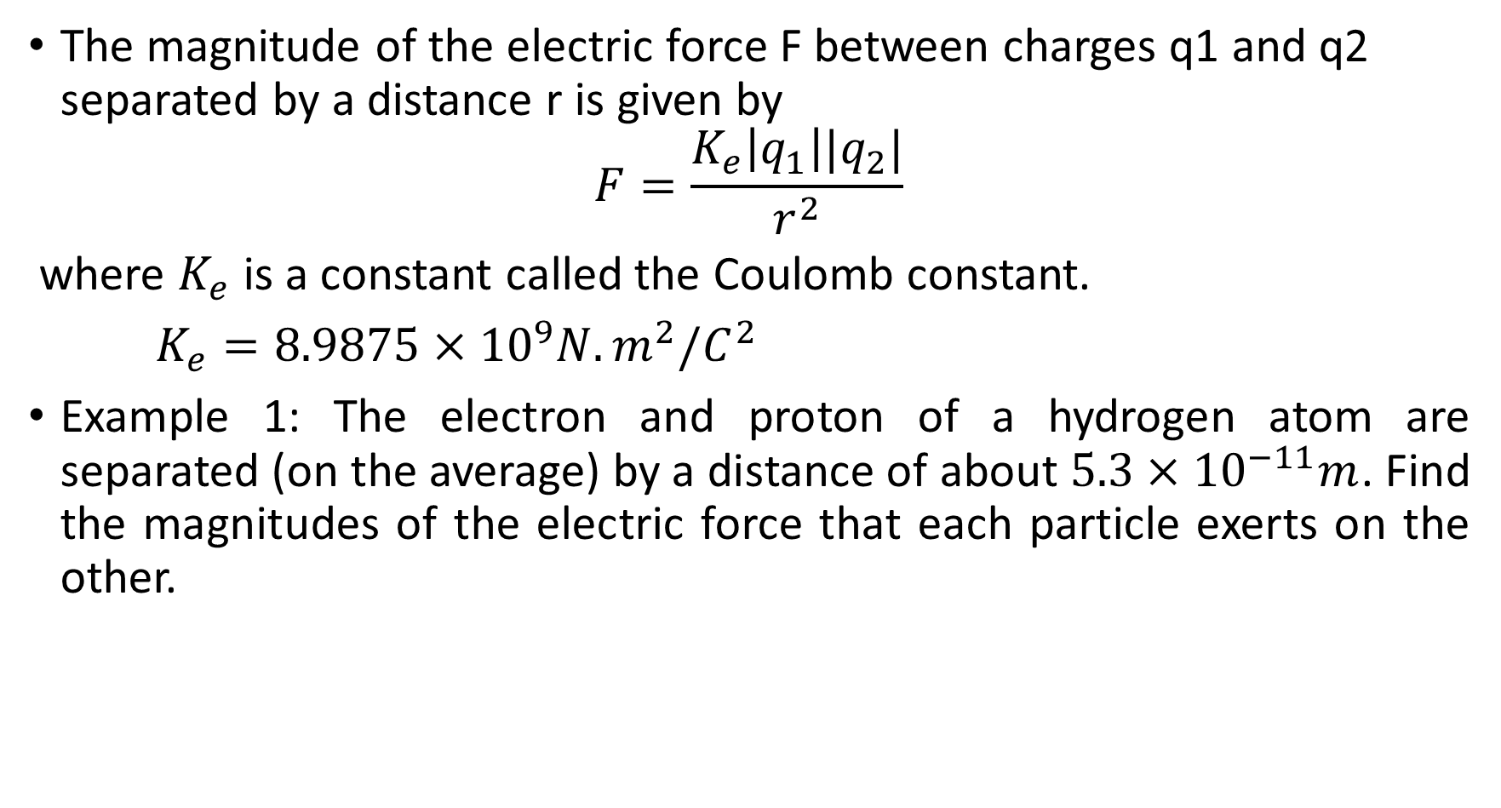
The magnitude of the electric force F between charges q1 and q2 separated by a distance r is given by
$$F=\frac{K_{e}\left|q_{1}\right||q_{2}|}{r^{2}}$$
where $K_{e}$ is a constant called the Coulomb constant.
$K_{e}=8.9875×10^{9}N.m^{2}/C^{2}$
Example 1: The electron and proton of a hydrogen atom are separated (on the average) by a distance of about $5.3×10^{−11}m$. Find the magnitudes of the electric force that each particle exerts on the other.

Slide 9

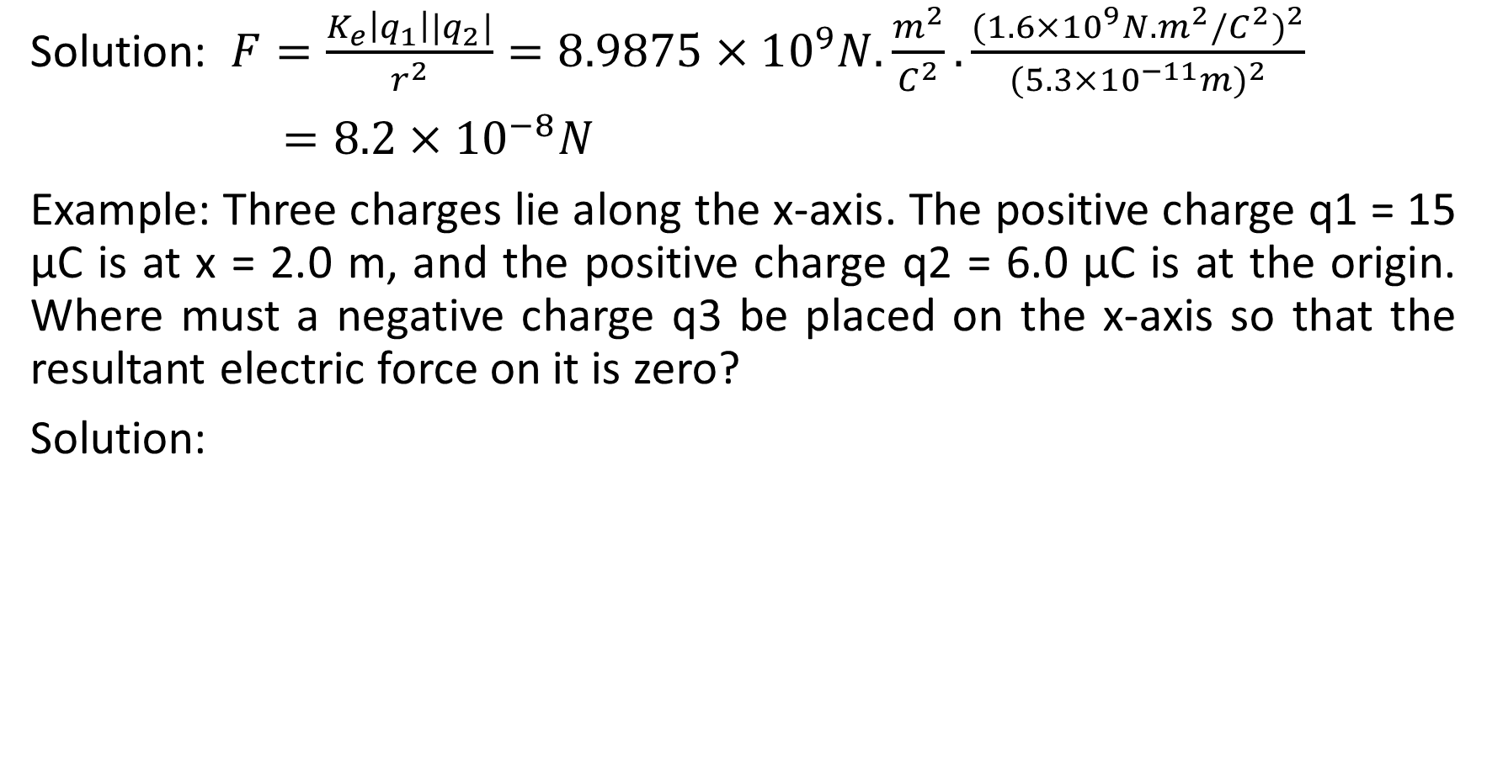
Solution: $F=\frac{K_{e}\left|q_{1}\right||q_{2}|}{r^{2}}=8.9875×10^{9}N.\frac{m^{2}}{C^{2}}.\frac{(1.6×10^{9}N.m^{2}/C^{2})^{2}}{(5.3×10^{−11}m)^{2}}$
$=8.2×10^{−8}N$
Example: Three charges lie along the x-axis. The positive charge q1 = 15 μC is at x = 2.0 m, and the positive charge q2 = 6.0μC is at the origin. Where must a negative charge q3 be placed on the x-axis so that the resultant electric force on it is zero?
Solution:

Slide 10
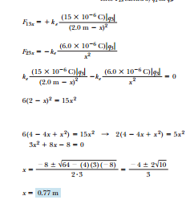

Slide 11
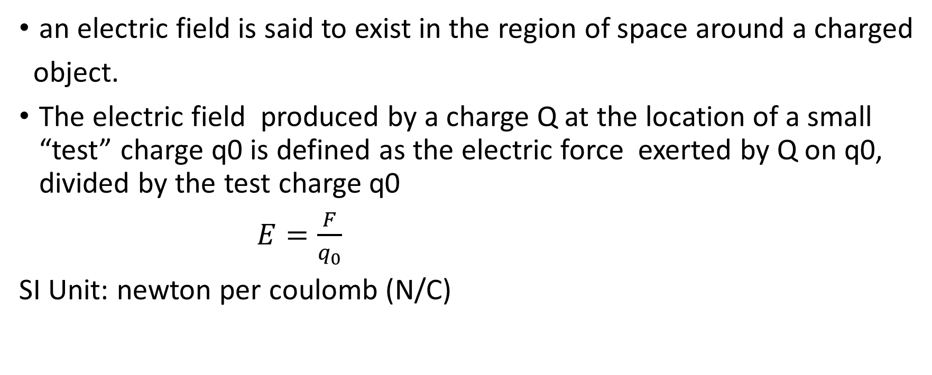
The Electric Field, Electric Field Lines, Electric Flux and Gauss’s Law
an electric field is said to exist in the region of space around a charged
object.
The electric field produced by a charge Q at the location of a small “test” charge q0 is defined as the electric force exerted by Q on q0, divided by the test charge q0
$E=\frac{F}{q_{0}}$
SI Unit: newton per coulomb (N/C)

Slide 12
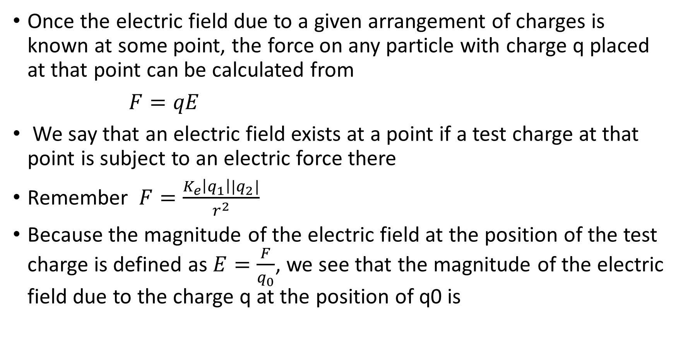
Once the electric field due to a given arrangement of charges is known at some point, the force on any particle with charge q placed at that point can be calculated from
$F=qE$
We say that an electric field exists at a point if a test charge at that point is subject to an electric force there
Remember $F=\frac{K_{e}\left|q_{1}\right||q_{2}|}{r^{2}}$
Because the magnitude of the electric field at the position of the test charge is defined as $E=\frac{F}{q_{0}}$, we see that the magnitude of the electric field due to the charge q at the position of q0 is

Slide 13
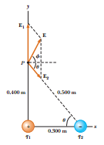

$F=\frac{K_{e}\left|q\right|}{r^{2}}$
Example: Charge q1 = 7.00 μC is at the origin, and charge q2 = 5.00μC is on the x-axis, 0.300 m from the origin. (a)Find the magnitude and direction of the electric field at point P, which has coordinates (0, 0.400) m. (b) Find the force on a charge of $2.0×10^{8}$ C placed at P.

Slide 14
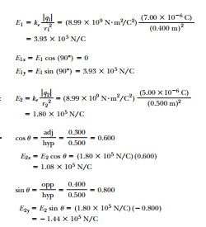

Slide 15
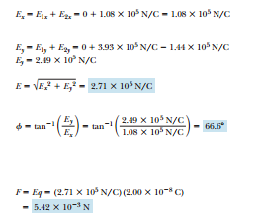


Slide 16
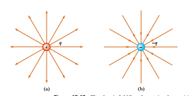
ELECTRIC FIELD LINES

Slide 17
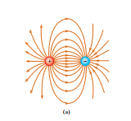
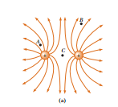

Slide 18
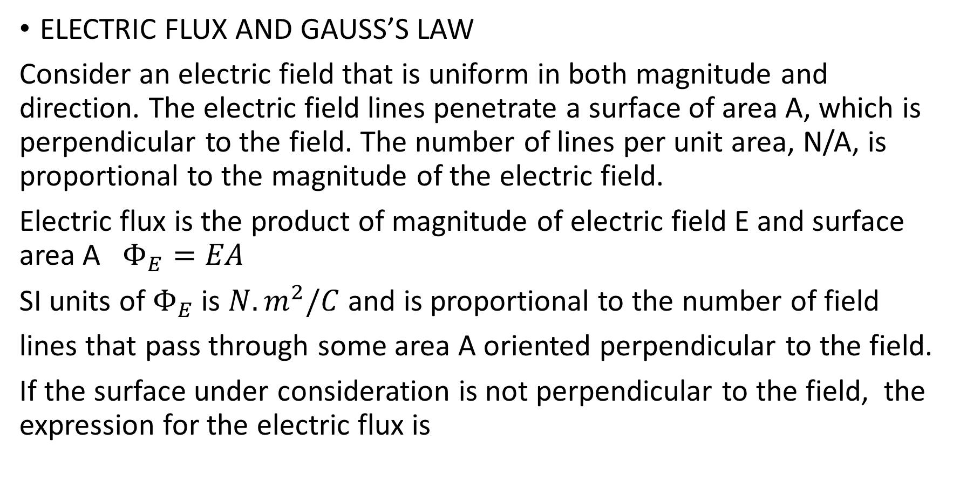
ELECTRIC FLUX AND GAUSS’S LAW
Consider an electric field that is uniform in both magnitude and direction. The electric field lines penetrate a surface of area A, which is perpendicular to the field. The number of lines per unit area, N/A, is proportional to the magnitude of the electric field.
Electric flux is the product of magnitude of electric field E and surface area A $Φ_{E}=EA$
SI units of $Φ_{E}$ is $N.m^{2}/C$ and is proportional to the number of field
lines that pass through some area A oriented perpendicular to the field.
If the surface under consideration is not perpendicular to the field, the expression for the electric flux is

Slide 19
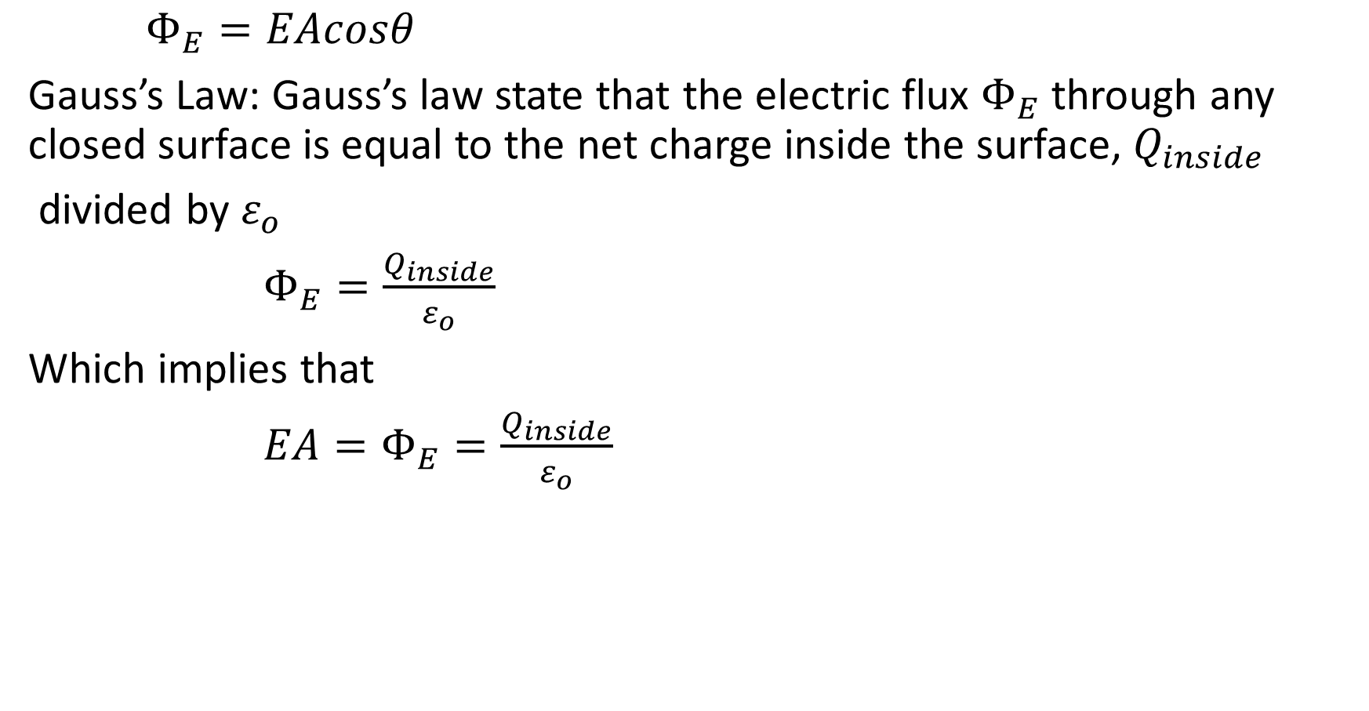
$Φ_{E}=EAcosθ$
Gauss’s Law: Gauss’s law state that the electric flux $Φ_{E}$ through any closed surface is equal to the net charge inside the surface, $Q_{inside}$
divided by $ε_{o}$
$Φ_{E}=\frac{Q_{inside}}{ε_{o}}$
Which implies that
${EA=Φ}_{E}=\frac{Q_{inside}}{ε_{o}}$

Slide 20
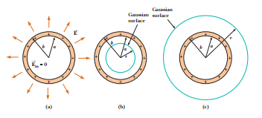
Example: A spherical conducting shell of inner radius a and outer radius b carries a total charge +Q distributed on the surface of a conducting shell. The quantity Q is taken to be positive. (a)Find the electric field in the interior of the conducting shell, for r < a, and (b)the electric field outside the shell, for r > b. (c) If an additional charge of –Q is placed at the center, find the electric field for r > b.
Solution:

Slide 21

a) $EA=E(4πr^{2})=\frac{Q_{inside}}{ε_{o}}=0⇒E=0$
$EA=E\left(4πr^{2}\right)=\frac{Q_{inside}}{ε_{o}}$
$E=\frac{Q_{inside}}{4πε_{o}r^{2}}=\frac{Q}{4πε_{o}r^{2}}$
c) $EA=E\left(4πr^{2}\right)=\frac{Q_{inside}}{ε_{o}}=\frac{+Q−Q}{ε_{o}}=0$

Slide 22
Capacitance, Combinations of Capacitors.
A capacitor is a device used in a variety of electric circuits —for example, to tune the frequency of radio receivers, eliminate sparking in automobile ignition systems, or store short-term energy for rapid release in electronic flash units.
Capacitance: The capacitance C of a capacitor is the ratio of the magnitude of the charge on either conductor (plate) to the magnitude of the potential difference between the conductors (plates).

Slide 23
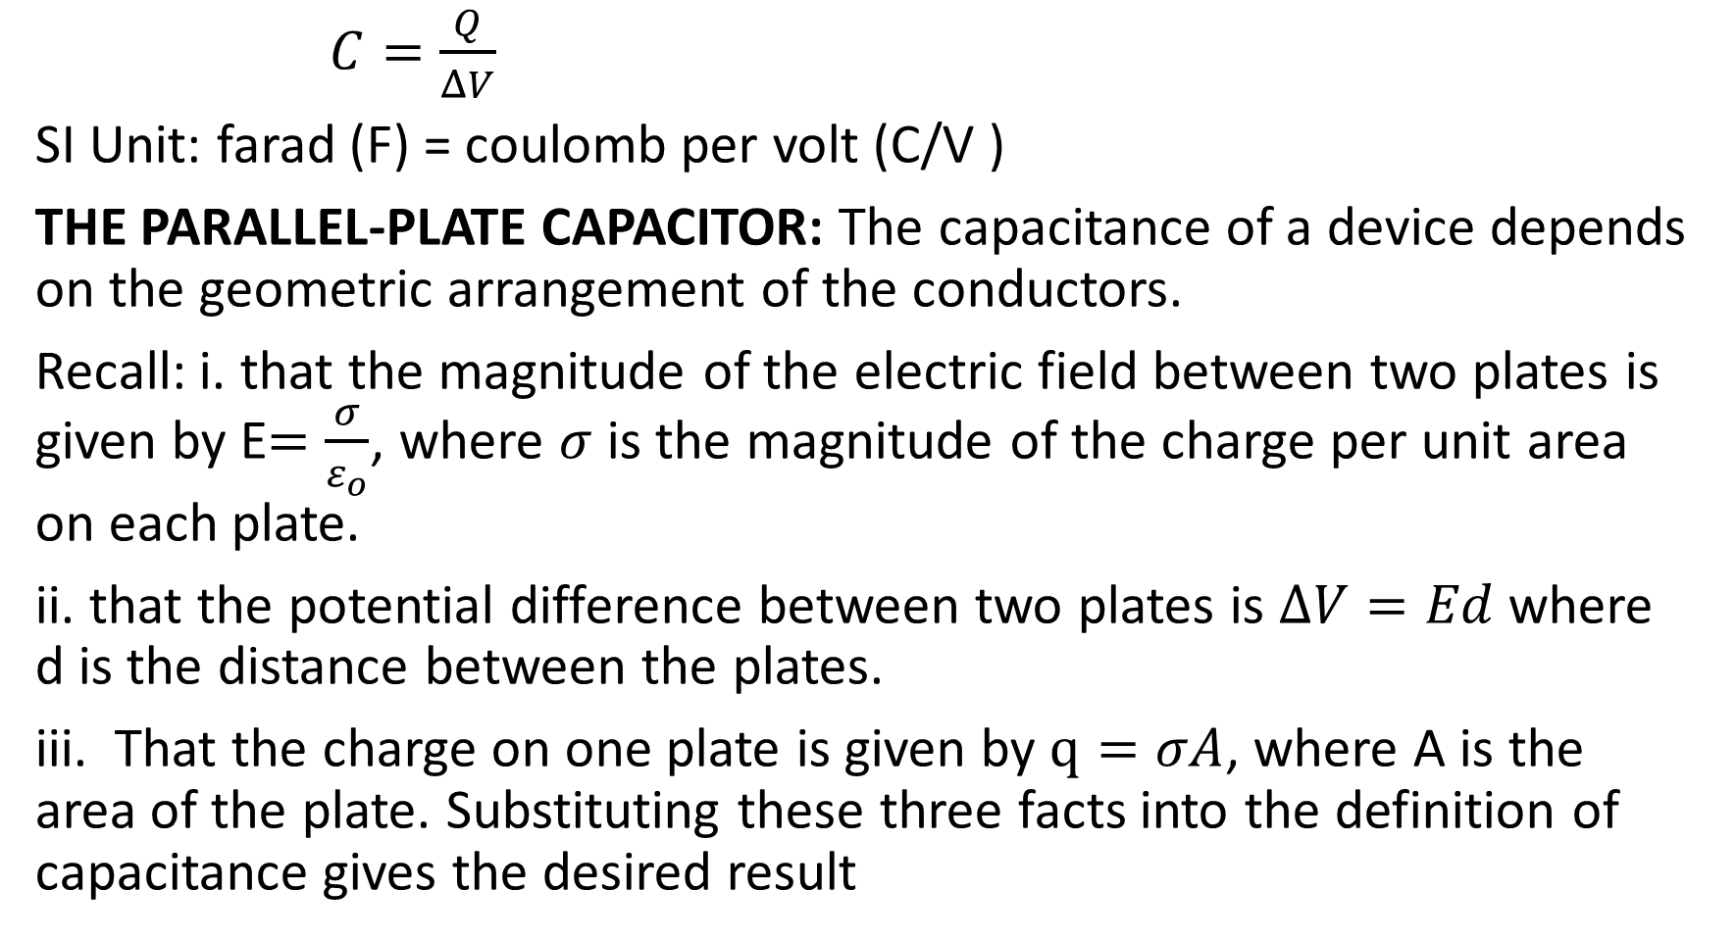
$C=\frac{Q}{ΔV}$
SI Unit: farad (F) = coulomb per volt (C/V )
THE PARALLEL-PLATE CAPACITOR: The capacitance of a device depends on the geometric arrangement of the conductors.
Recall: i. that the magnitude of the electric field between two plates is given by E$=\frac{σ}{ε_{o}}$, where $σ$ is the magnitude of the charge per unit area on each plate.
ii. that the potential difference between two plates is $ΔV=Ed$where d is the distance between the plates.
iii. That the charge on one plate is given by $q=σA$, where A is the area of the plate. Substituting these three facts into the definition of capacitance gives the desired result

Slide 24
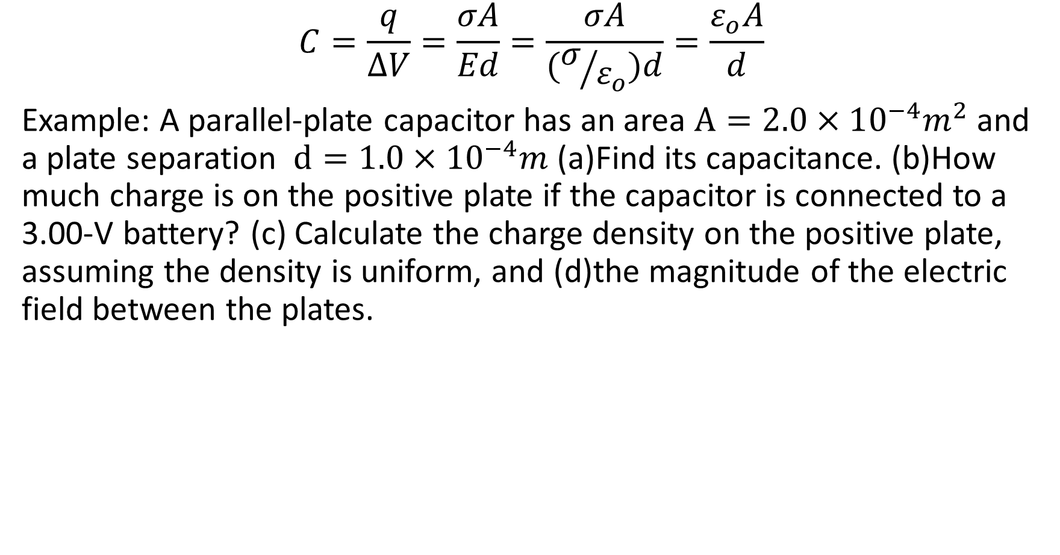
$$C=\frac{q}{ΔV}=\frac{σA}{Ed}=\frac{σA}{(σ/{ε_{o}})d}=\frac{ε_{o}A}{d}$$
Example: A parallel-plate capacitor has an area $A=2.0×10^{−4}m^{2}$ and a plate separation $d=1.0×10^{−4}m$(a)Find its capacitance. (b)How much charge is on the positive plate if the capacitor is connected to a 3.00-V battery? (c) Calculate the charge density on the positive plate, assuming the density is uniform, and (d)the magnitude of the electric field between the plates.

Slide 25
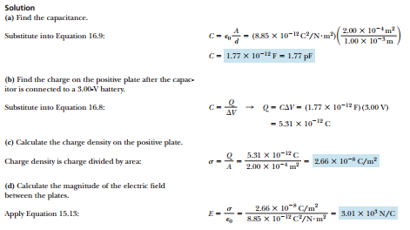

Slide 26
COMBINATIONS OF CAPACITORS
Capacitors in Parallel: Two capacitors connected as shown in Figure below are said to be in parallel. The left plate of each capacitor is connected to the positive terminal of the battery by a conducting wire, so the left plates are at the same potential. In the same way, the right plates, both connected to the negative terminal of the battery, are also at the same potential. This means that capacitors in parallel both have the same potential difference V across them.

Slide 27
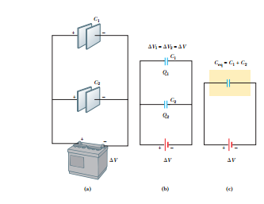

Slide 28

$$Q=Q_{1}+Q_{2}$$
$Q_{1}=C_{1}∆V$and $Q_{2}=C_{2}∆V$
$Q=C_{eq}∆V$
$C_{eq}∆V=C_{1}∆V+C_{2}∆V$
$C_{eq}=C_{1}+C_{2}$
$C_{eq}=C_{1}+C_{2}+…+C_{n}$

Slide 29
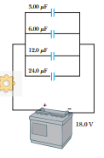
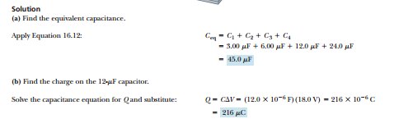
Example: (a)Determine the capacitance of the single capacitor that is equivalent to the parallel combination of capacitors shown in Figure below, and (b) find the charge on the 12.0 μF capacitor.

Slide 30
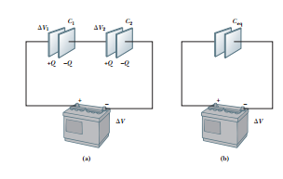
Capacitors in Series: For a series combination of capacitors, the magnitude of the charge must be the same on all the plates.

Slide 31

$$∆V=\frac{Q}{C_{eq}}$$
$∆V_{1}=\frac{Q}{C_{1}}$ and $∆V_{2}=\frac{Q}{C_{2}}$
$∆V=∆V_{1}+∆V_{2}$
$\frac{Q}{C_{eq}}=\frac{Q}{C_{1}}+\frac{Q}{C_{2}}$
$\frac{1}{C_{eq}}=\frac{1}{C_{1}}+\frac{1}{C_{2}}+…+\frac{1}{C_{n}}$

Slide 32
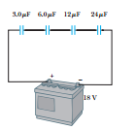
Example: Four capacitors are connected in series with a battery, as in Figure below (a) Calculate the capacitance of the equivalent capacitor. (b) Compute the charge on the 12-μF capacitor. (c)Find the voltage drop across the 12- μF capacitor

Slide 33
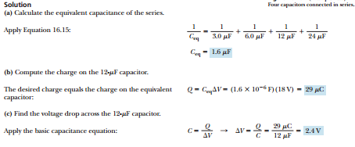

Slide 34
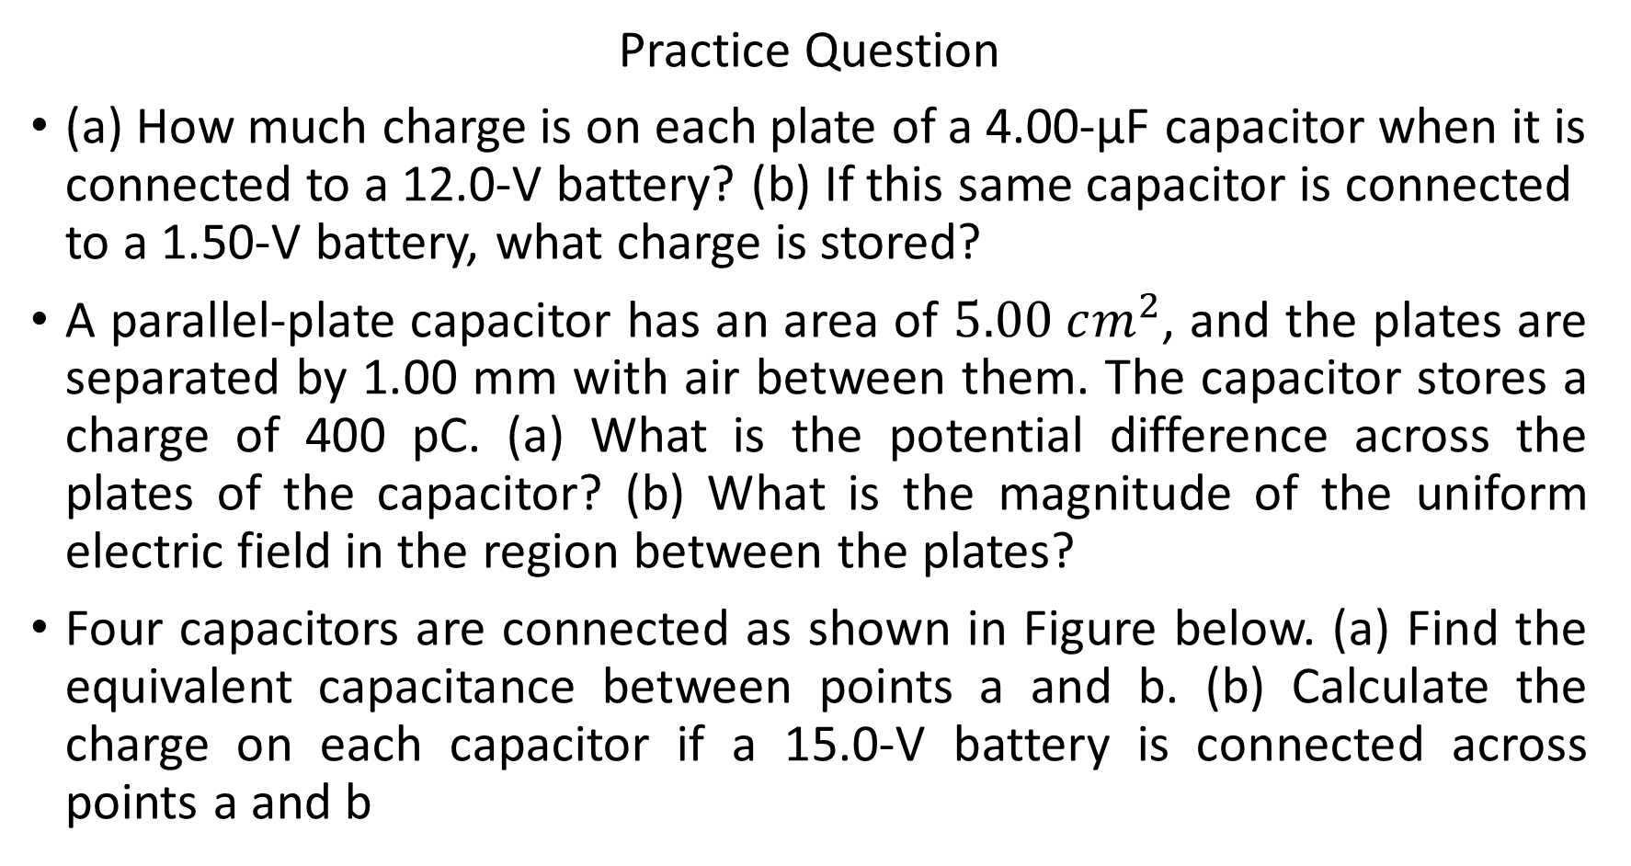
Practice Question
(a) How much charge is on each plate of a 4.00-μF capacitor when it is connected to a 12.0-V battery? (b) If this same capacitor is connected to a 1.50-V battery, what charge is stored?
A parallel-plate capacitor has an area of $5.00 cm^{2}$, and the plates are separated by 1.00 mm with air between them. The capacitor stores a charge of 400 pC. (a) What is the potential difference across the plates of the capacitor? (b) What is the magnitude of the uniform electric field in the region between the plates?
Four capacitors are connected as shown in Figure below. (a) Find the equivalent capacitance between points a and b. (b) Calculate the charge on each capacitor if a 15.0-V battery is connected across points a and b

Slide 35


Slide 36
Recommended Text
College Physics for Scientist and Engineers with Modern Physics, Seventh Edition by John W. Jewett, Jr. and Raymond A. Serway
Schaum’s Series Outline, College Physics, Ninth Edition BY Frederick J. Bueche and Eugene Hecht.

